Slide 1


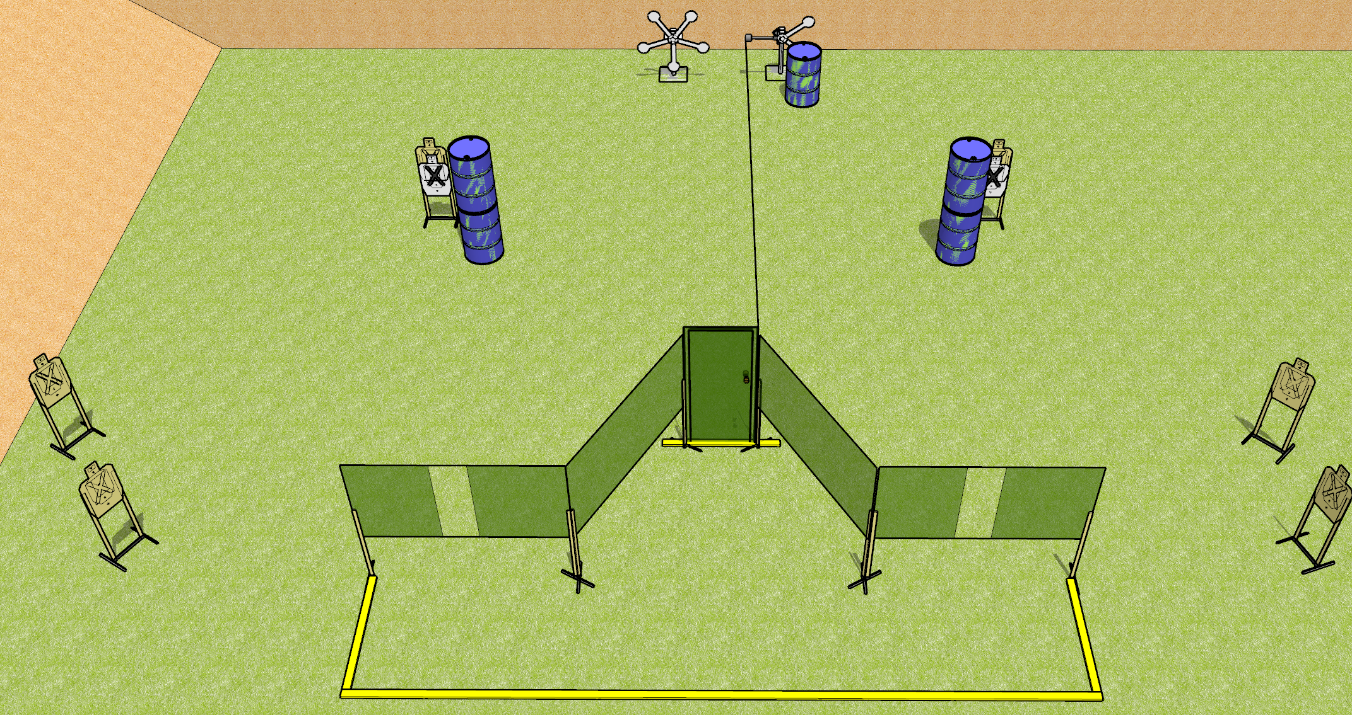
 | Dothan Gun Club – USPSA Match Star Power Course Designer : Drew Coleman
START POSITION : Standing with either hand touching doorknob, other hand wrist below belt. PCC buttstock on belt, muzzle touching doorknob.
GUN READY CONDITION : Pistol loaded and holstered. PCC loaded, held with both hands, shouldered, safety on. |  | SCORING: Comstock, 19 rounds TARGETS: 6 paper, 7 Steel SCORED HITS: Best 2 on paper, steel until down START-STOP: Audible, last shot RULES:
STAGE PROCEDURE: Engage targets as they become available from within the fault lines.

Slide 2
Star Power
Written Stage Briefing
Star Power is a 19 round, 95 point, Comstock medium course. There are six USPSA targets and seven falling steel. The best two hits on paper will score, and steel must fall to score. The start signal is audible.
The swinging steel target is activated by the door. It must be activated before being engaged. Please check the activator prior to walkthrough and set it the same way every time.
Handgun start position is standing with either hand touching the door handle, other hand wrist below belt. Handgun is loaded and holstered.
PCC start position is standing with muzzle touching door handle. Loaded carbine is held with both hands, safety on, shouldered.
On start signal, engage targets as they become available from within the shooting area.

